Slide 1

Flight Management System
赵晗 符策彬
Sakura：
姜力 赖成溪

Slide 2
Customer Module
目录
Register Module
Contents
Administrator Module

Slide 3
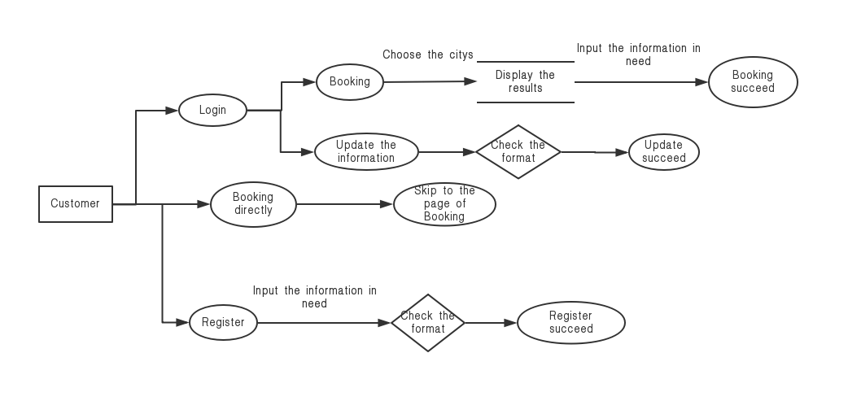

Slide 4
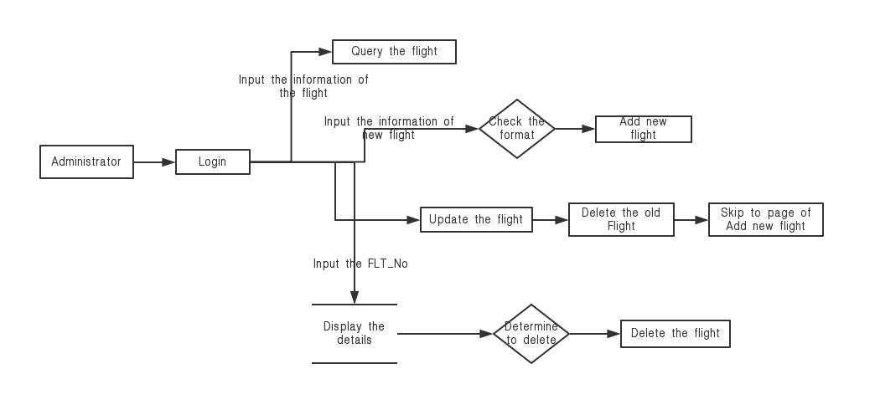

Slide 5
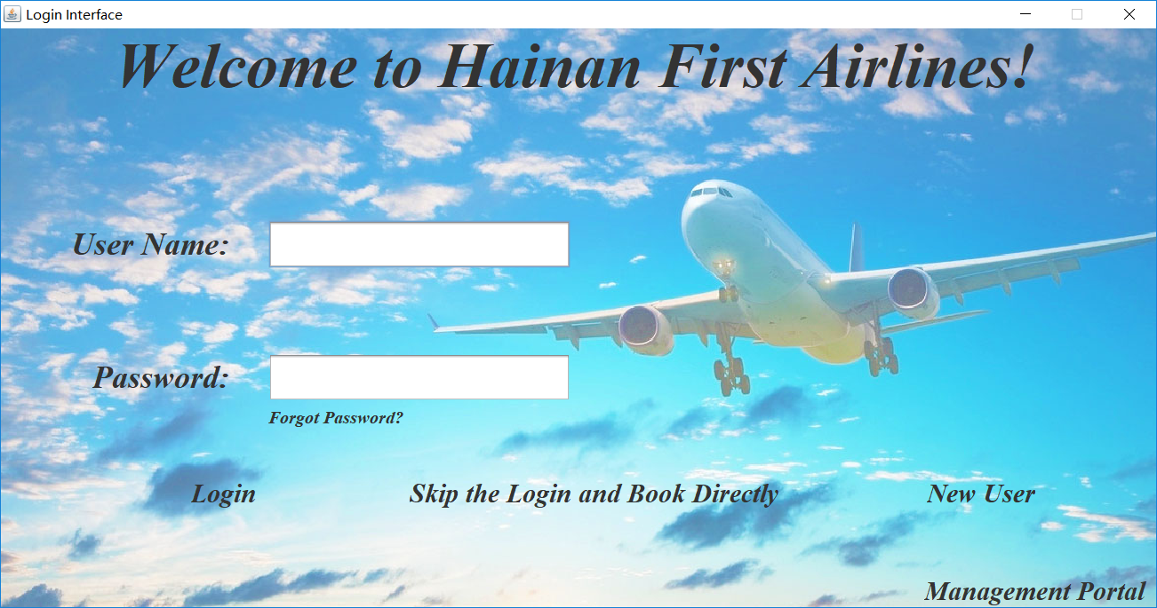
1.Customer Module Main Interface

Slide 6
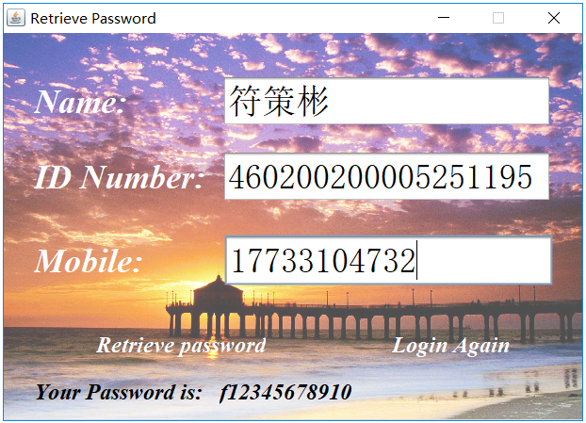
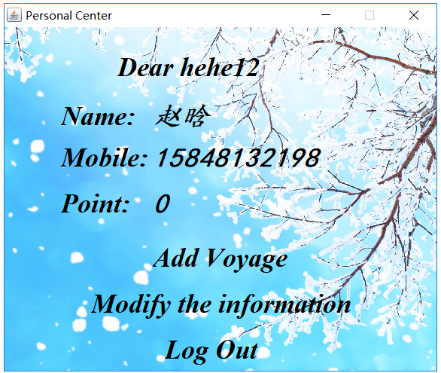
1.Customer Module
Retrieve Password
Personal Center

Slide 7
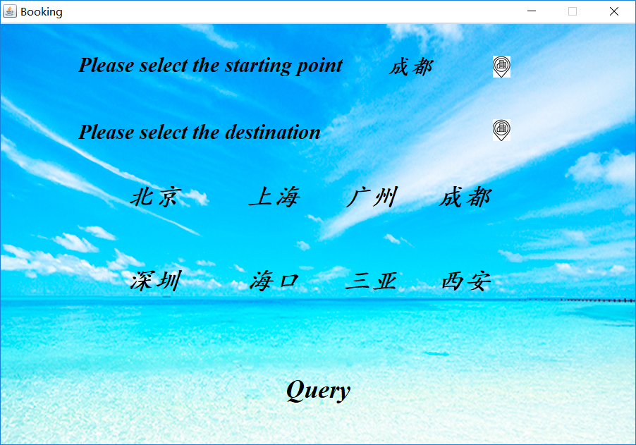
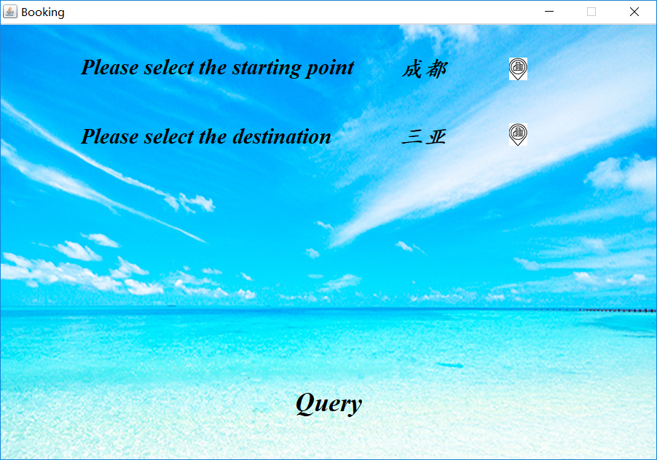
1.Customer Module
Departure
Destination

Slide 8
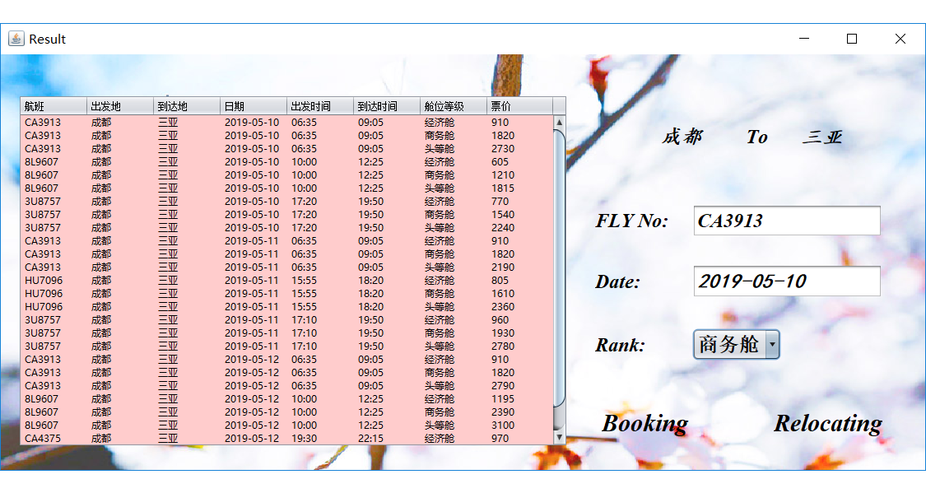
1.Customer Module Query Result

Slide 9
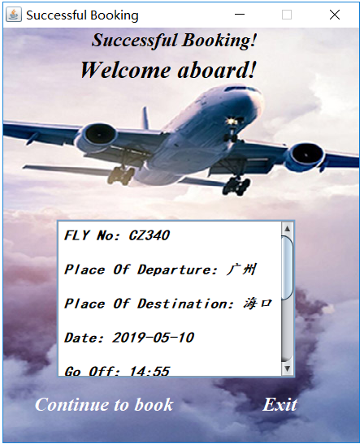
1.Customer Module
Successful Booking
Display Flight Information

Slide 10
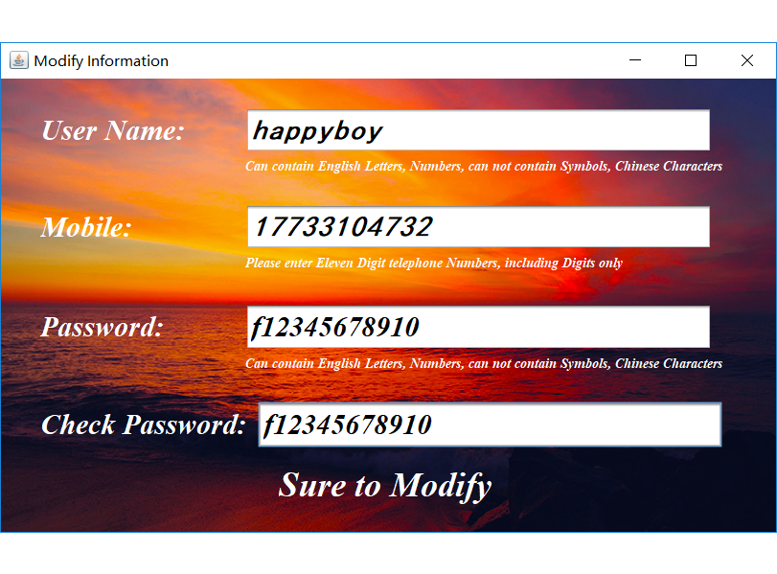
1.Customer Module Modify Personal Information

Slide 11
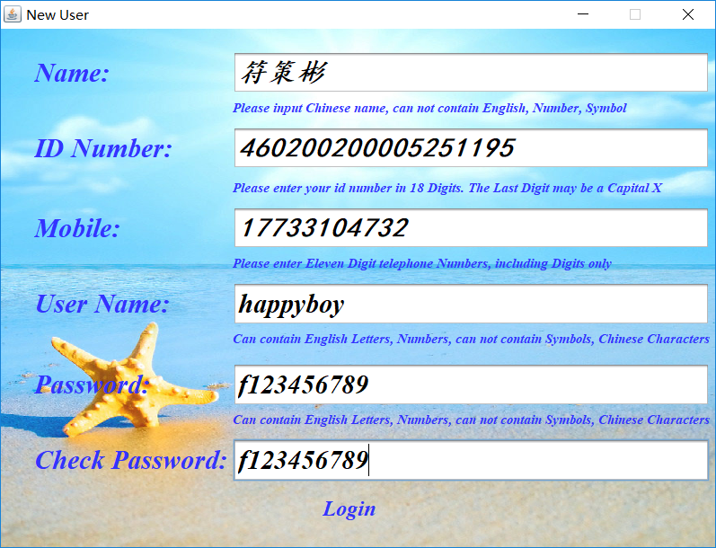
2.Register Module New User Registration

Slide 12
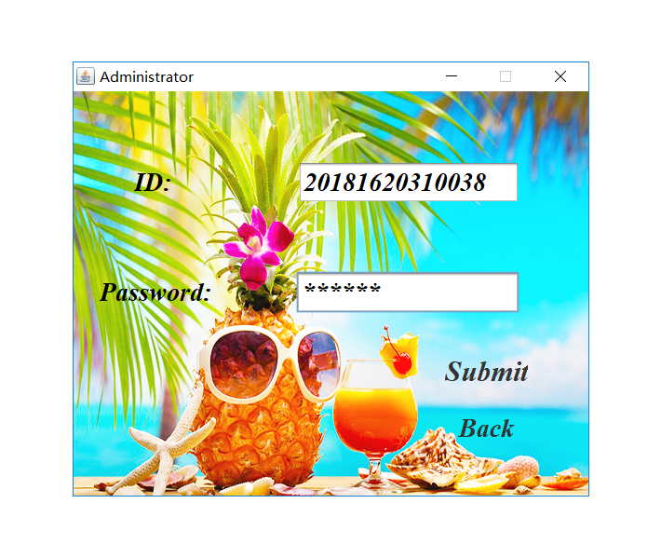
3.Administrator Module Administrator Login

Slide 13
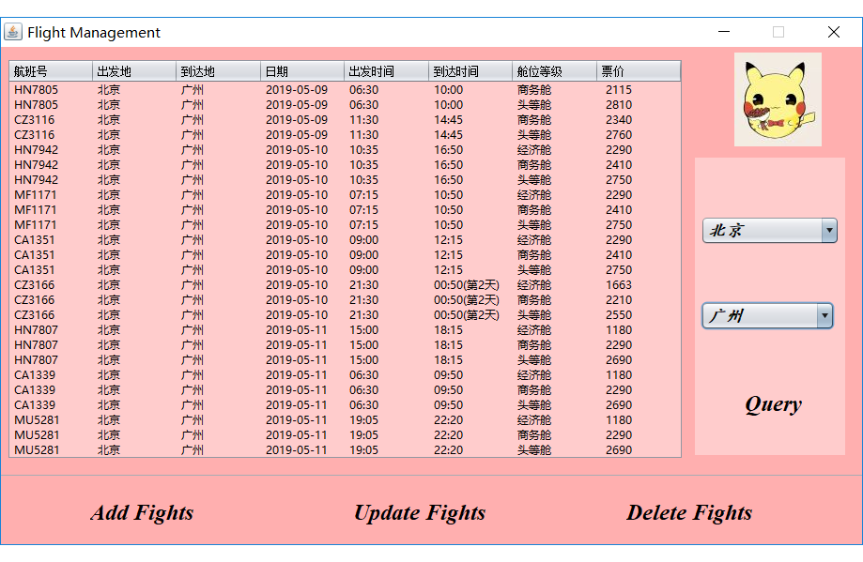
3.Administrator Module Flight Management

Slide 14
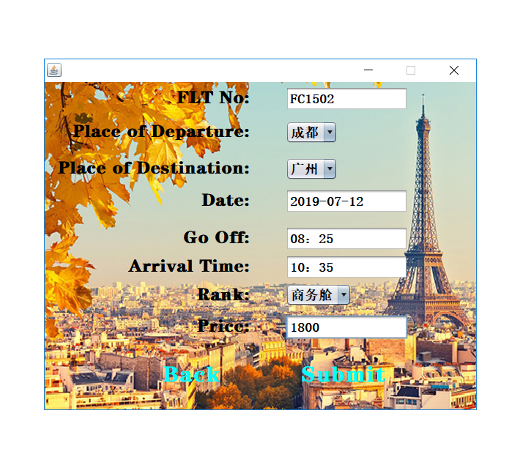
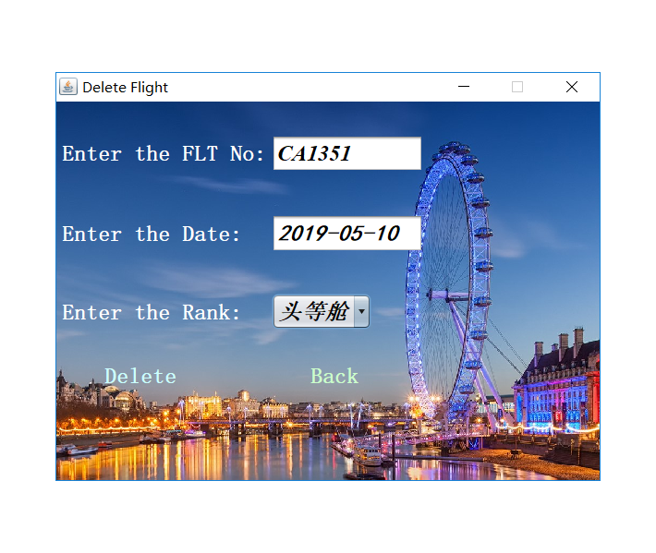
3.Administrator Module
New Flight
Delete Flight

Slide 15
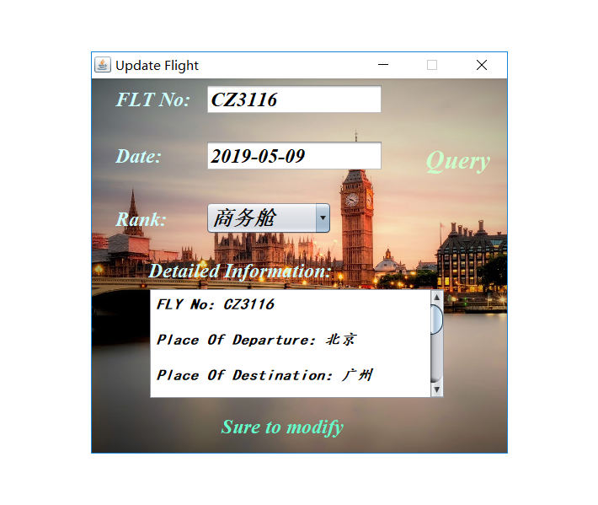
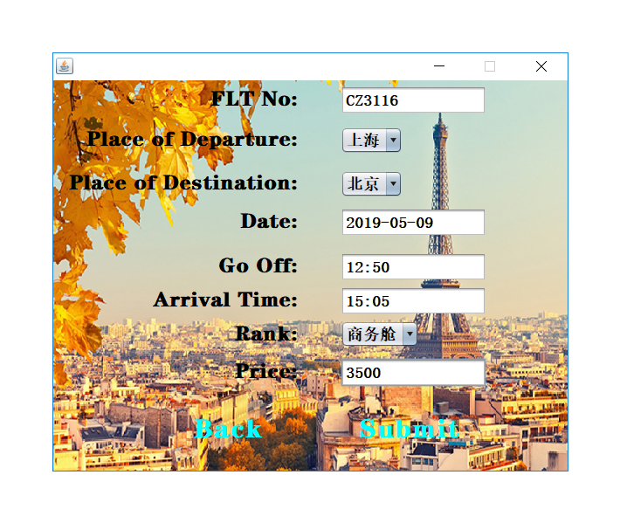
3.Administrator Module
Update Flight （1）
Update Flight （2）

Slide 16
Thanks

